Slide 1


SAVE THE DATE
2-5 December
The international Symposium on Resistance Arteries
www.isra2024.org

Slide 2

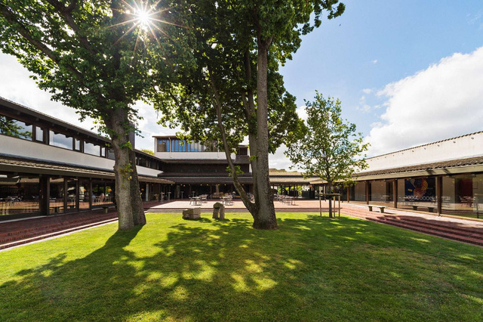



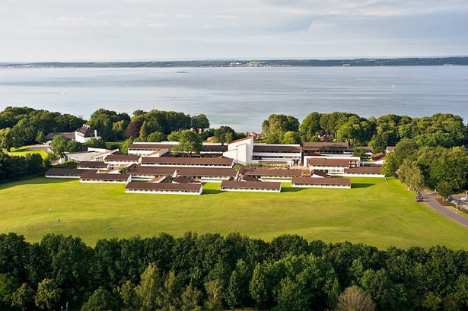
Submit your abstract for ISRA 2024
ISRA 2024
Venue
Konventum in Elsinore - Denmark
THE ABSTRACT SUBMISSION
IS OPEN
Go submit you abstarct on
isra2024.org/abstracts/
Submission deadline
25 September

Slide 3

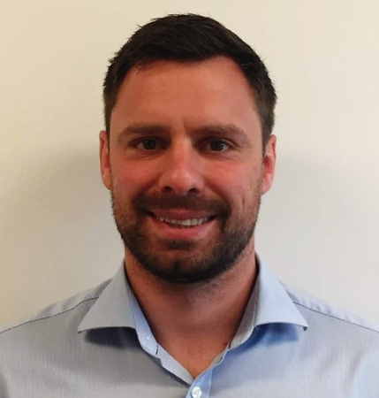
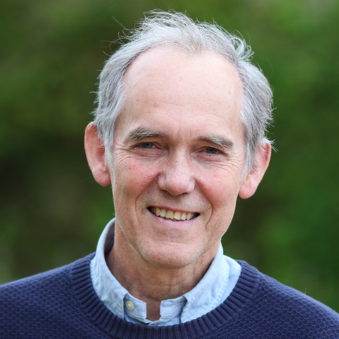
Local Organizing Committee
Associate Professor Thomas Jepps
ISRA 2024
President
Professor
Christian Aalkjær
ISRA 2024
Vice President
For more information go to www.isra2024.org

